Slide 1
Introduction to Descriptive Analytics
Introduction to Analyzing Data for Business Goals

Slide 2
Learning Goals
Discuss the best way to use descriptive analytics for your data strategy.
Investigate considerations for how descriptive analytics will help you solve the business problem for your final project.
Define descriptive analytics and the techniques of descriptive analytics.

Slide 3
Describe what is happening
What is happening in the business right now?
What trends exist in our historical data?
What actions can we take?

Slide 4
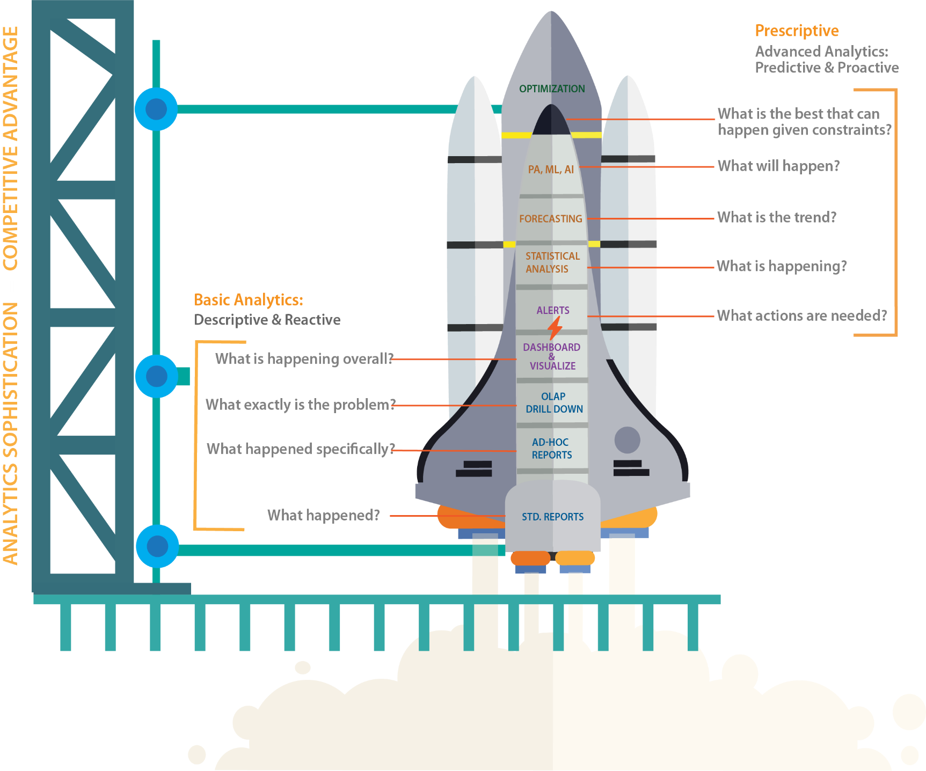
Data Science Operating Model
http://analytics.rsystems.com/wp-content/uploads/dlm_uploads/2017/04/R-Systems_Analytics-Sophistication_Thought_Leadership_Whitepaper.pdf

Slide 5
Descriptive Analytics
What is Descriptive Analytics?
Comprises the earliest part of the analytics chain.
It sets the stage for being able to make diagnoses, predictions, and recommendations for specific actions in support of business goals.
Precedes diagnostic, predictive, and prescriptive analytics.

Slide 6
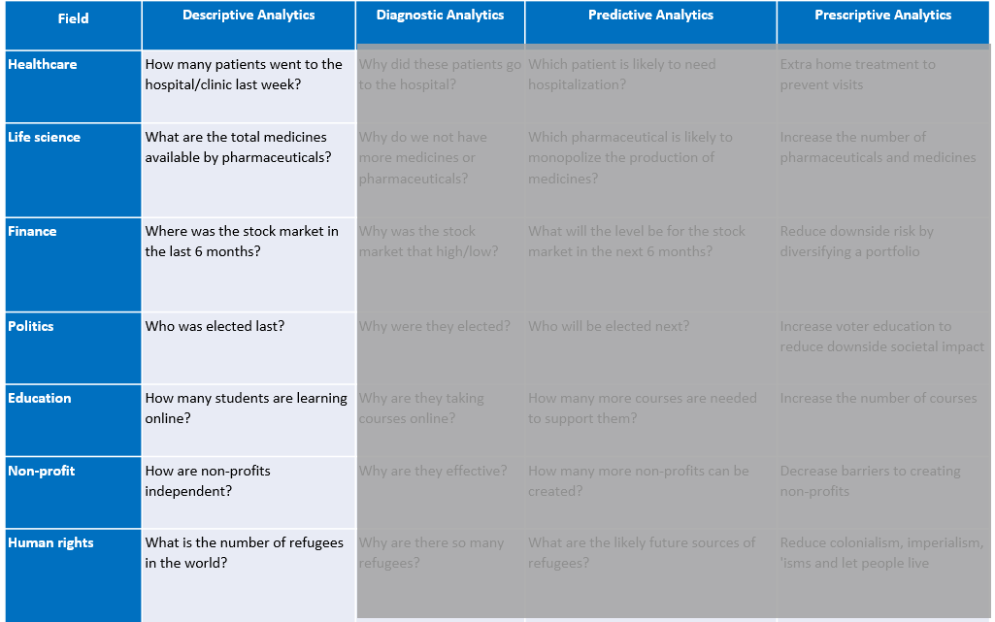
Recall the types of questions we can answer

Slide 7
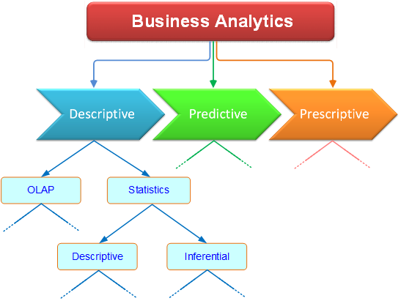
Techniques of Descriptive Analytics
Statistics
Descriptive Statistics
Inferential
Online Analytics Processing (OLAP)

Slide 8
Descriptive Statistics
The descriptive statistics used to summarize individual data series are usually grouped into two categories
Centrality
Mean
Median
Mode
Dispersion (the scattering of values of a variable around the mean or median of a distribution)
Standard Deviation
Variance
Range

Slide 9
Common Descriptive Stats
Mean: Also known as the average, the mean is calculated by summing the values in a dataset and then dividing by the number of values. The mean provides a notion of centrality in the data.
Median: This is the value in the middle of the given numerical data series. It is determined by sorting the data and identifying the specific value of the data point in the middle. If the data series has an even number of instances, then the two data points in the middle are averaged to calculate the median.
Mode: The mode is the value appearing most frequently in a dataset.
Standard deviation: The standard deviation measures the amount of variability among the values in a dataset.
Variance: The variance is the square of the standard deviation.
Maximum and Minimum: These are the largest and smallest values, respectively, in a given numerical data series.
Range: The range is the numerical distance between the maximum and minimum values.
Correlation: The correlation is a measure of the linear relationship between two variables.

Slide 10
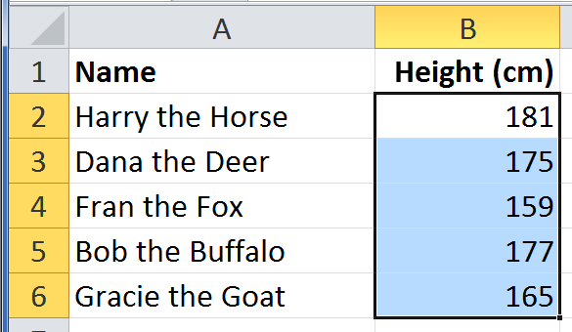
Techniques of Descriptive Analytics
Summarizing a Dataset
image credit: https://openelectiondata.net/en/academy/a-gentle-introduction-to-summarizing-data/
Notes:
Here is a simple example of summarizing a dataset

Slide 11
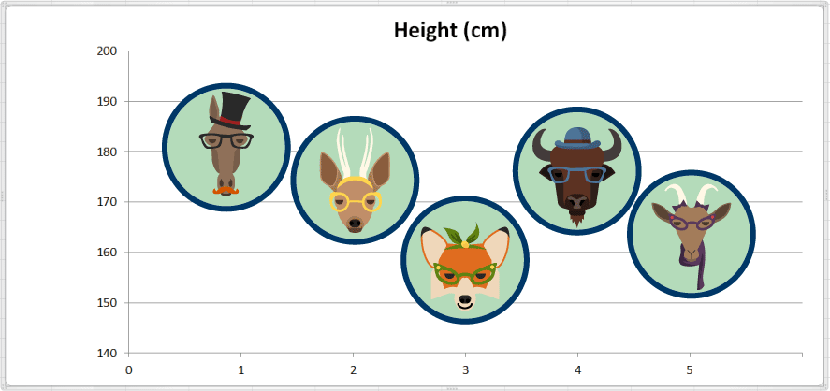
Techniques of Descriptive Analytics
Summarizing a Dataset - Plotting the data
image credit: https://openelectiondata.net/en/academy/a-gentle-introduction-to-summarizing-data/
Notes:
Here is a simple example of summarizing a dataset

Slide 12
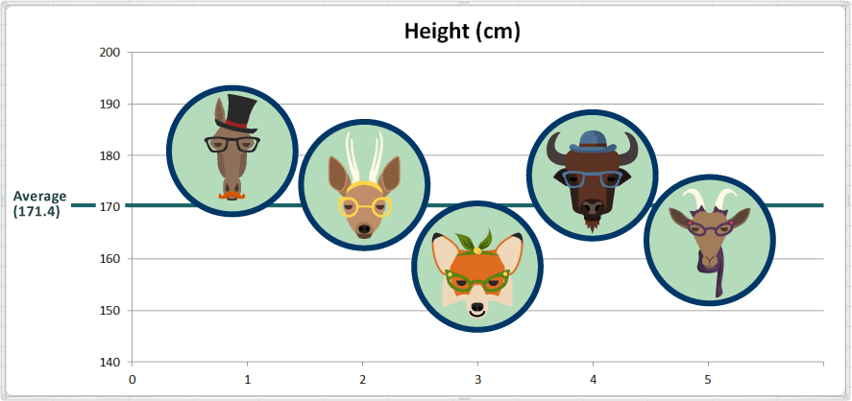
Techniques of Descriptive Analytics
Average height = (181 + 175 + 159 + 177 + 165) ÷ 5 = 857 ÷ 5 = 171.4
image credit: https://openelectiondata.net/en/academy/a-gentle-introduction-to-summarizing-data/
Notes:
Here is a simple example of summarizing a dataset

Slide 13
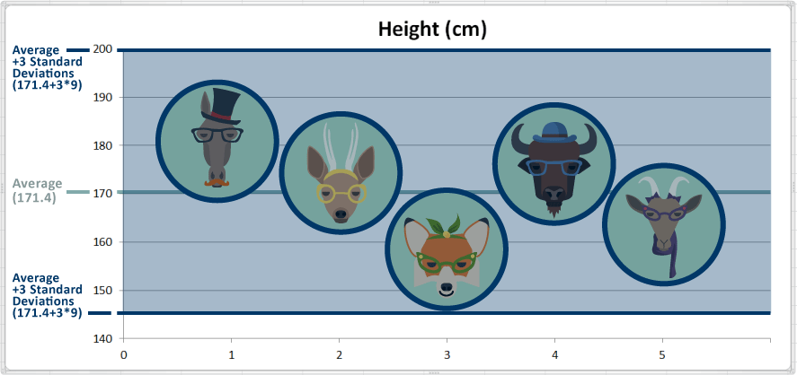
Techniques of Descriptive Analytics
Standard Deviation, Low Value, High Value, Mode
image credit: https://openelectiondata.net/en/academy/a-gentle-introduction-to-summarizing-data/
Notes:
Here is a simple example of summarizing a dataset

Slide 14
Considerations for Creating Descriptive Analytics
Asking the right questions
Selecting Valuable Data Sources
Business Challenges
- Missing Time Series Data
- Transforming Variables
Interpretation of Meaning

Slide 15
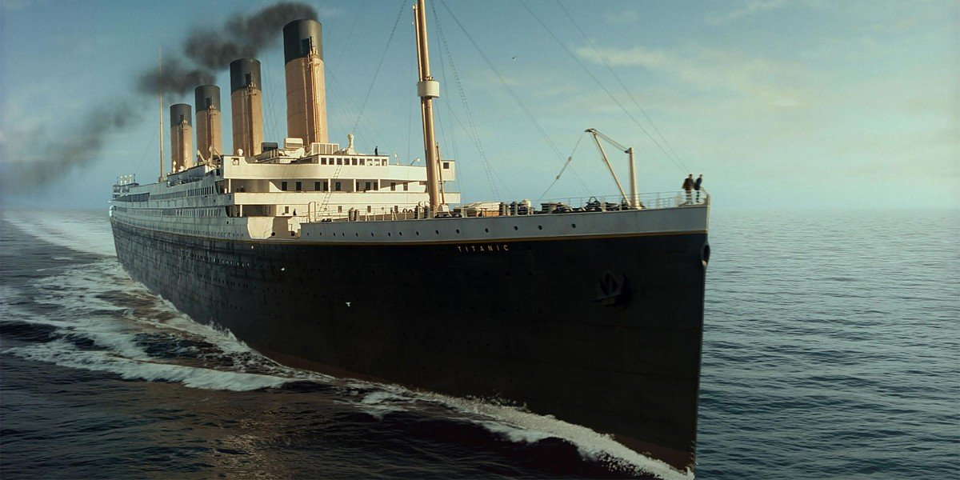
Application Case: Explore the Titanic Dataset
Practice answering questions from the Titanic dataset under Day-4 “In-Class Activities”.
What Descriptive can you ask of this data?
What question(s) will you ask?
How will descriptive analytics provide the answer?
What are the techniques and/or tools you might use?
What are the challenges and/or risks of using descriptive analytics?
Notes:
https://www.kaggle.com/vinicius150987/titanic3

Slide 16
Assignment
Consider the business problem you wish to solve for your final project and answer the following questions:
What question(s) will you ask?
How will descriptive analytics provide the answer?
What are the techniques and/or tools you might use?
What are the challenges and/or risks of using descriptive analytics?
Refer to the four types of data analytics section in the reading from Day 1 for guidance. This will be added to your final strategy project.

Slide 17

Q&A
What questions and comments do you have?

